Slide 1







Enterprise Blockchain Developers (Intermediate)
In support of
Powered By

Slide 2
Outline
What is ERC721
Code Demo: How to create a Debt ERC721
What is Opensea
Opensea Sales Model
Code Demo: Opensea Creatures Code Explaination
© 2017-2020 SmartMesh Foundation Pte. Ltd. | MeshBox Foundation Pte. Ltd.

Slide 3
What is ERC721
ERC721 tokens, more commonly referred to as Non-Fungible tokens (NFTs).
Non-Fungible tokens allow developers to tokenize ownership of any arbitrary data, drastically increasing the design space of what can be represented as a token on the Ethereum blockchain.
The biggest differentiator of Non-Fungible tokens is that
each one is tied to a different identifier, making each token unique to its owner. This is much different to tokens leveraging the ERC20 token standard, which is a token standard for fungible tokens, meaning each token is interchangeable.
In the ERC20 token standard, developers can create any number of tokens within one contract, but in the ERC721 token standard, each token within the contract holds a different value.

Slide 4
What is ERC721
interface IERC721 is IERC165 {
event Transfer(address indexed from, address indexed to, uint256 indexed tokenId);
event Approval(address indexed owner, address indexed approved, uint256 indexed tokenId);
event ApprovalForAll(address indexed owner, address indexed operator, bool approved);
function balanceOf(address owner) external view returns (uint256 balance);
function ownerOf(uint256 tokenId) external view returns (address owner);
function safeTransferFrom(address from, address to, uint256 tokenId) external;
function transferFrom(address from, address to, uint256 tokenId) external;
function approve(address to, uint256 tokenId) external;
function getApproved(uint256 tokenId) external view returns (address operator);
function setApprovalForAll(address operator, bool _approved) external;
function isApprovedForAll(address owner, address operator) external view returns (bool);
function safeTransferFrom(address from, address to, uint256 tokenId, bytes calldata data) external;
}

Slide 5
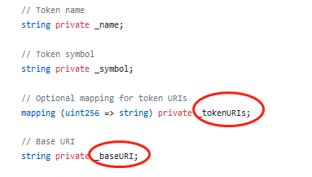
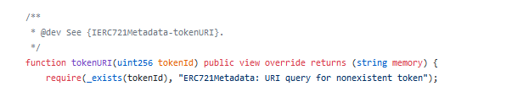
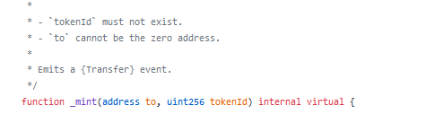
What is ERC721
ERC721 code walk through

Slide 6
What is ERC721
1. Approval and Operator
enables or disables (`approved`) `operator` to manage all of its assets
Operators can call {transferFrom} or {safeTransferFrom} for any token owned by the caller
2. TokenURI store all the metadata for this NFT
how to make it more decentralized or transparent: IPFS

Slide 7
How to Create Debt ERC721
ERC721 Code Demo

Slide 8
What is Opensea
The largest marketplace for digital goods
OpenSea is the first and largest marketplace for user-owned digital goods, which include collectibles, gaming items, domain names, digital art, and other assets backed by a blockchain.
i.e. NTF market : Decentralized Ecommerce Market place

Slide 9
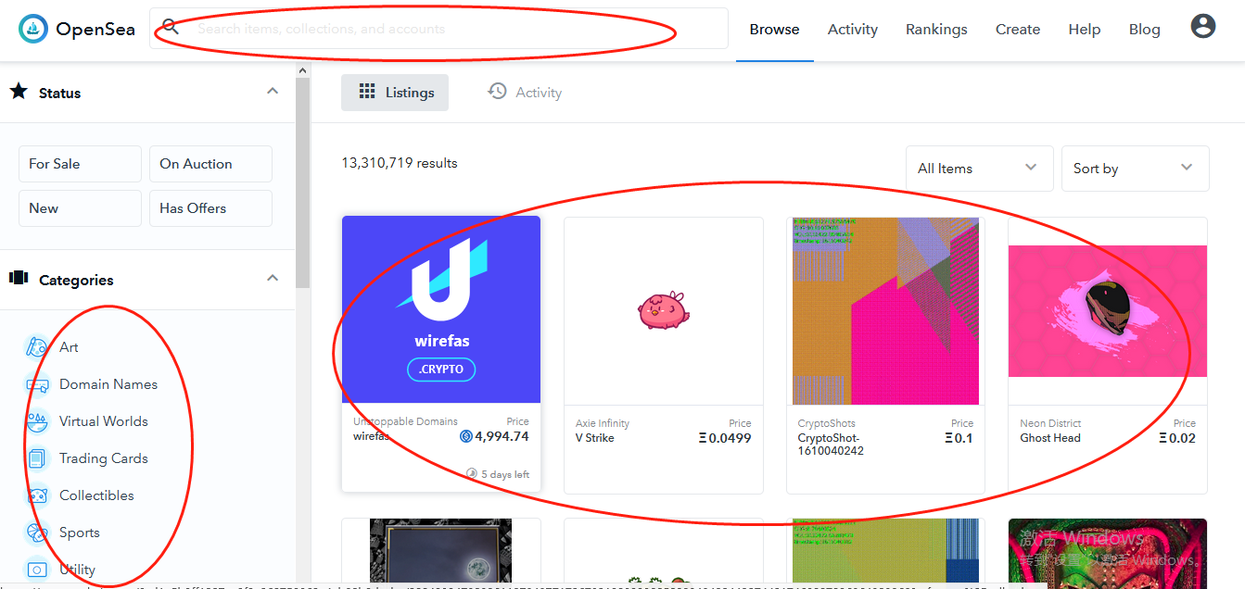
What is Opensea
Category - Search Bar - Goods Listing (go through the website)

Slide 10
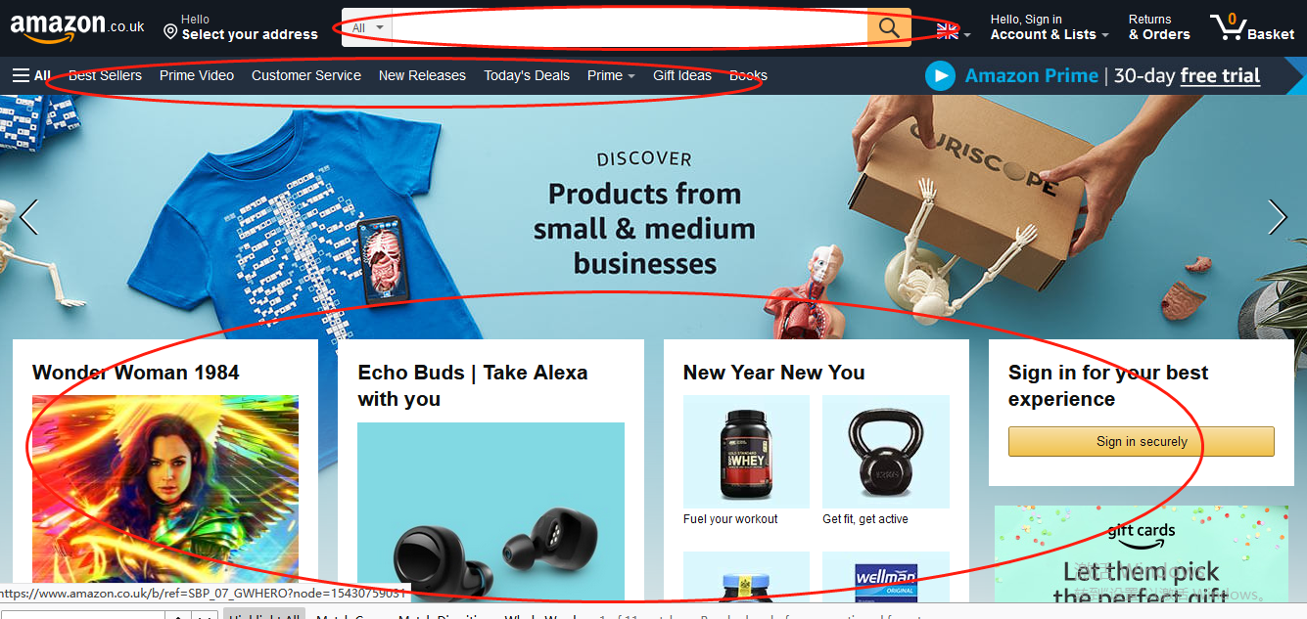
What is Opensea
Category - Search Bar - Goods Listing (go through the website)

Slide 11
What is Opensea
Real Logic Behind NFT
Centralized Orgnization or Individual Redeem
(Real world)
NFT TOKEN
TOKENURI
Decentralized Sale
(Digital world)

Slide 12
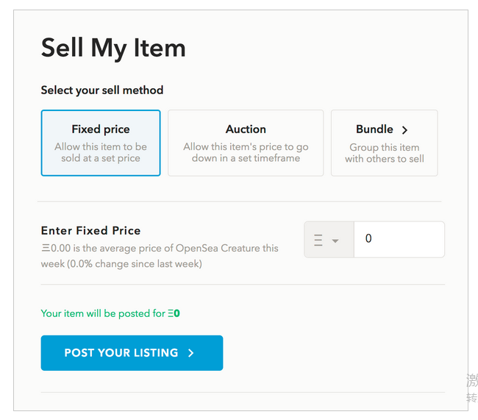
Opensea Sales Model
Simple Item sale (Demo)

Slide 13
Opensea Sales Model
Factory Sale
the Factory owner can "sell" options. However, when an option is sold, instead of getting transferred to the buyer, the mint method for that particular optionId gets called. So, for example, if I were to sell _optionId 1 of the CreatureFactory contract, to 0xab23d, then mint(1, '0xab23d') would get called. Since the logic for that optionId is to mint 4 OpenSea creatures, 0xab23d would receive 4 brand new creatures.

Slide 14
Opensea Sales Model
Lootbox Sale
Each lootbox can be traded just like regular items — but they can also be "opened" to redeem the actual game item. For example, a game might want to issue a pack of items randomly generating an item of a certain ability level, or a set of cards with some probability of getting a "mythic" or "legendary" card.

Slide 15
Opensea Creatures Code Explaination
Demo and Code Explaination
Flattner
A third proxy pattern
Contract
Proxy
Logic

Slide 16
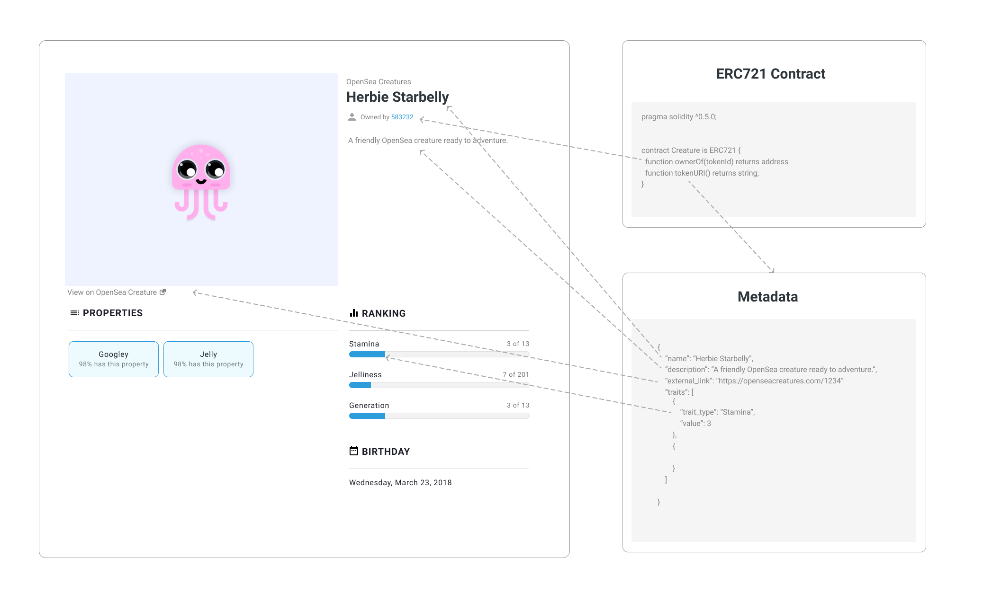
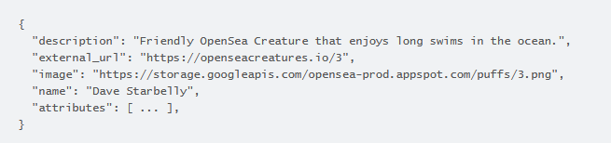
Opensea Metadata
Data Structure
Contract
Proxy
Logic

Slide 17
What is Flask
Flask is a web application framework written in Python
Flask is based on Werkzeug WSGI toolkit and Jinja2 template engine. Both are Pocco projects.
So we can use this to write frontend and backend

Slide 18
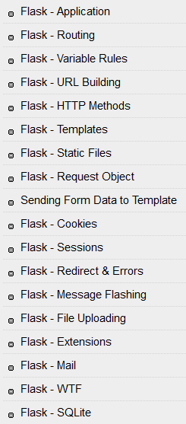
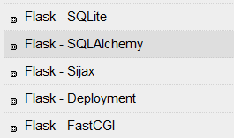
What is Flask
https://www.tutorialspoint.com/flask/index.htm
backend / api service
Application is main program
routing and variable rules contral the logic
see code
Templates is the front end
SQLite is the and SQLalchemy is the data model

Slide 19
Setup Metadata service with Flask
Code Demo

